Slide 1

Object Classification in Urban Aerial Drone Footage
Jack, Aidan, Liam

Slide 2
Contents
Research
Objective
Dataset
Data Preparation
Baseline Model
Custom Model
Evaluation
Conclusions

Slide 3
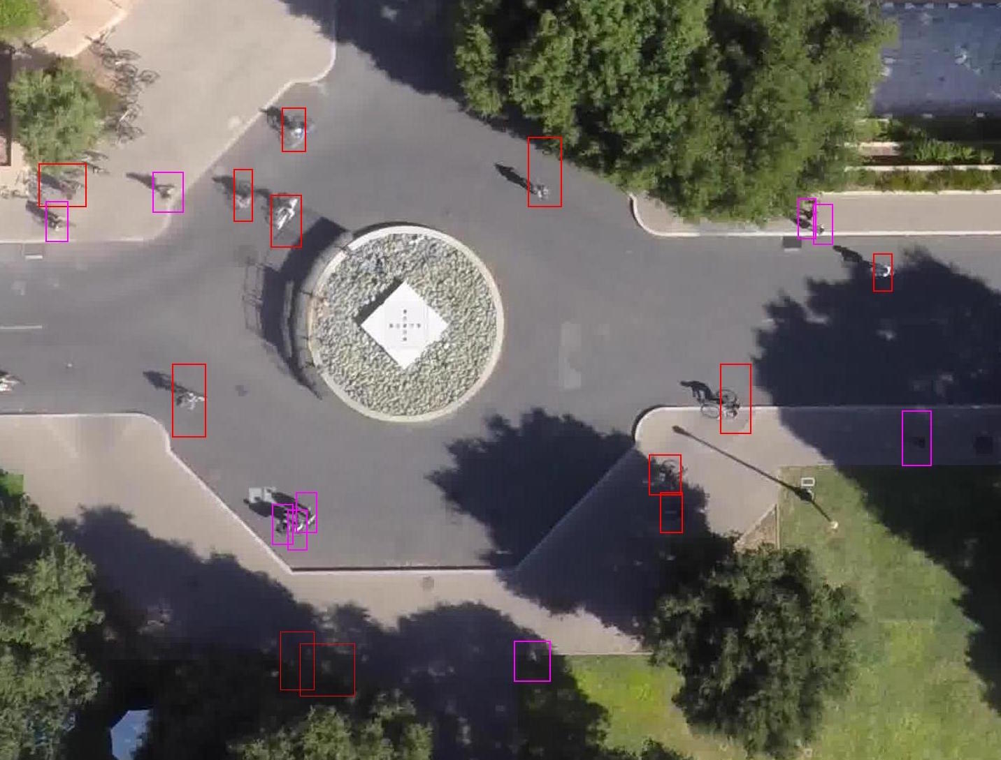
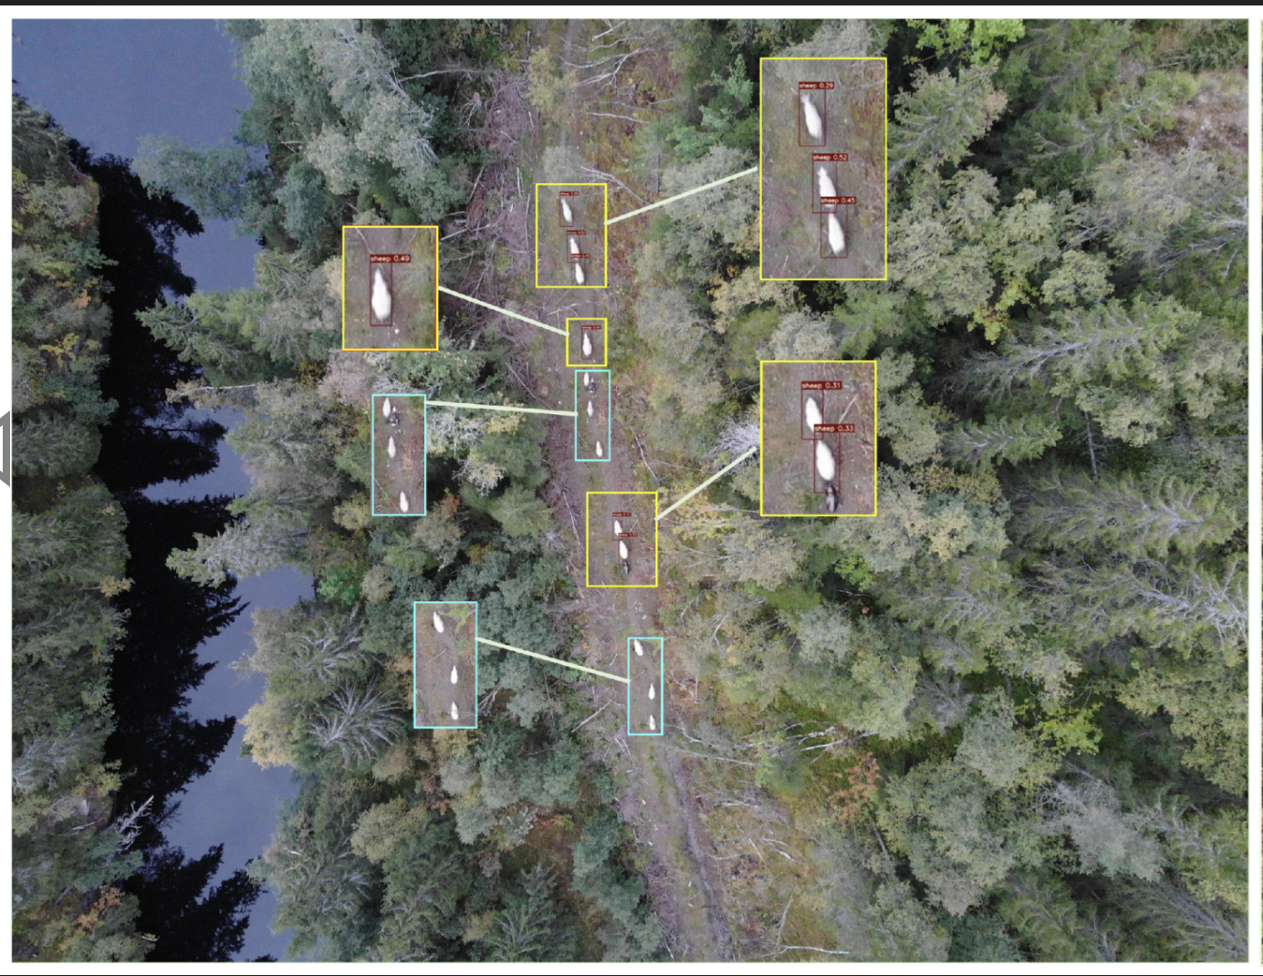
1) Research
Stanford Drone Dataset: goal to
predict social etiquette and “common
sense” pedestrian behavior
Wildlife Detection Dataset: goal to
effectively monitor small-scale
wildlife movement

Slide 4
2) Objective:
Create a computer vision object classification model to identify objects in aerial drone imagery.
Potential real-world applications include environmental monitoring, autonomous drone delivery, endangered wildlife tracking, disaster response, search and rescue, aerial surveillance, and much more.

Slide 5
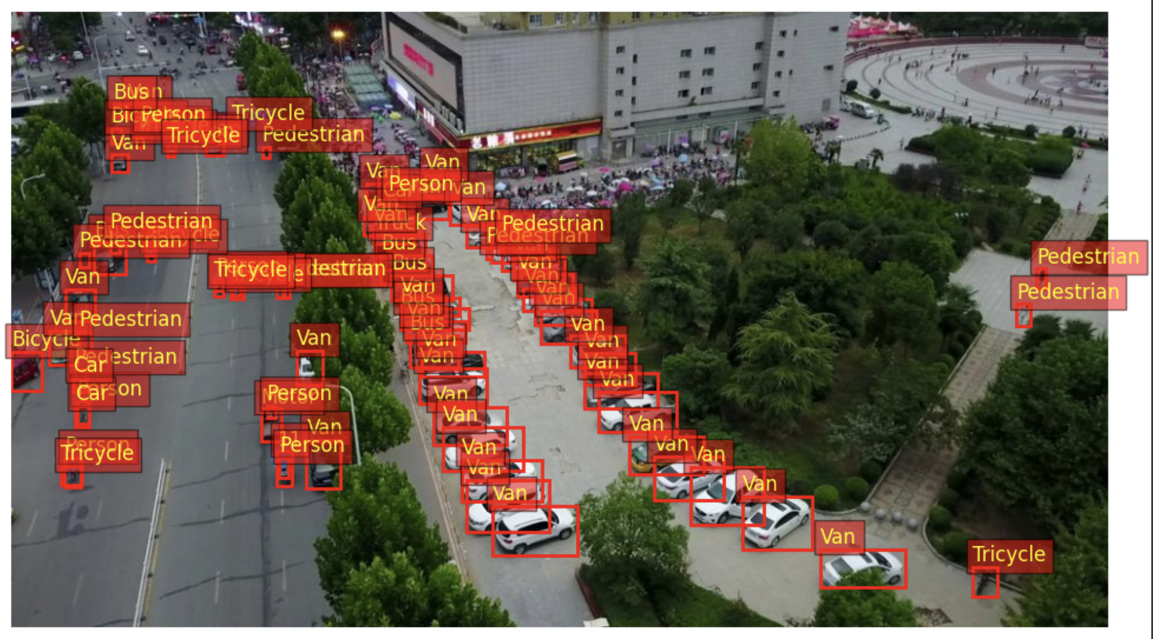
3) Dataset
VisDrone Dataset (“Vision Meets
Drones: A Challenge”): A large
repository of drone images and
footage published by the
VisDrone challenge, an annual
competition held by Tianjin
University. This dataset is frequently used as a benchmark for a wide range of aerial-based computer vision projects.
300 videos ~260,000 frames ~10,000 images
12 different classes - from people to bike to car etc
Notes:
300 videos ~260,000 frames ~10,000 images
12 different classes - from people to bike to car etc

Slide 6
4) Data Preparation
Download individual training, validation, and test datasets provided by VisDrone
Explore class distributions, annotated bounding box training images, label distinctions, image complexity / environments
Complete data preprocessing steps such as image size standardization, scaling bounding boxes, converting images to tensors, label mapping, removing outliers
Create data loaders using small subset of each dataset
For faster model iteration + GPU limits

Slide 7
5) Baseline Model
Load the pre-trained Torchvision fasterrcnn_resnet50_fpn model and replace classifier head with VisDrone labels
Details:
Fast R-CNN detector integrated with a more advanced Region Proposal Network (RPN)
Residual Network (ResNet) with 50 layers
Feature Pyramid Network (FPN) for better feature extraction at different scales
Object detection model pre-trained on COCO dataset (330,000+ images and wide variety of locations)

Slide 8
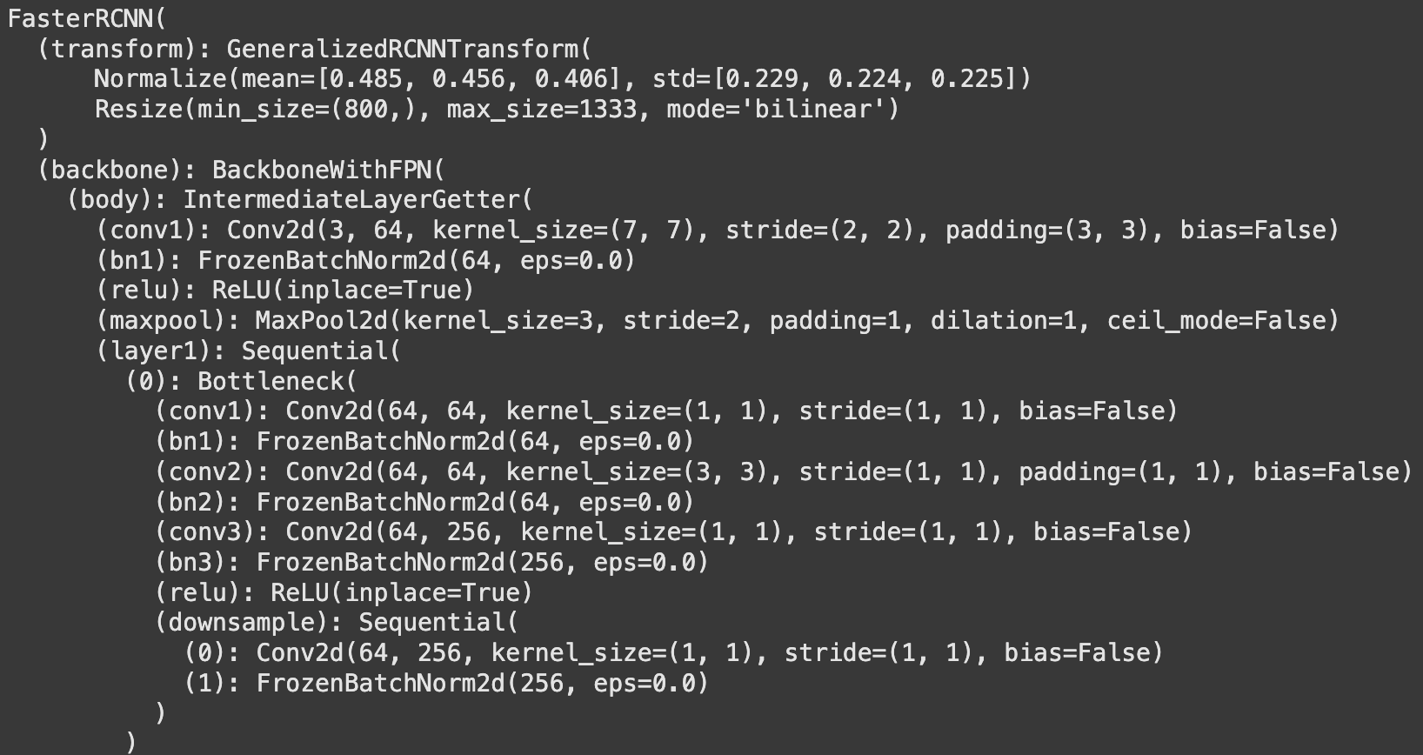
Baseline Model Architecture
Baseline model # of parameters: 41,133,136
Model Layers:

Slide 9
6) Custom Model
Builds on Baseline model architecture (pre-trained Torchvision fasterrcnn_resnet50_fpn model in which classifier head has been replaced with VisDrone labels)
Key differences:
Custom anchor sizes for bounding boxes in RPN
Implements advanced Region of Interest (RoI) pooling for multi-scale feature maps, and aligns RoIs to the feature maps with better preservation of spatial information (i.e. no quantization)
Dropout regularization of new MLP head “mini-model”
Various training optimizations

Slide 10
Custom Model Architecture
Transfer Learning:
Load pretrained ResNet-50 with FPN (better suited for drone images)
Freeze or allow fine-tuning
Remove original detection layers (head)
Region Proposal Network (RPN):
Use built-in RPN layers to generate regions
Custom anchor sizes (16, 32, 64, 128, 256) and aspect ratios (0.5, 1.0, 2.0)
Region of Interest (ROI) Head:
Customize ROI detection box head layers with p=0.5 dropout regularization
Custom two-layer MLP head with 1024 neurons
Add final box predictor, specified for VisDrone data
Training Optimizations:
Data augmentation
Optimizers (Adam, L2 regularization)
Learning rate scheduling
Early stopping

Slide 11
7) Evaluation
Model evaluation criteria are adapted from VisDrone’s official competition criteria:
Average Precision: “quality”
Precision = TP / (TP + FP)
Measures the accuracy of classifications and precision of bounding boxes
Intersection over Union (the closeness of two bounding boxes)
Average Recall: “quantity”
Recall = TP / (TP + FN)
Measures the model’s ability to find all the relevant objects in an image
Mean Average Precision: “overall performance”
mAP is calculated as the average of Average Precision scores across all classes
Provides a single metric that summarizes model’s performance
Notes:
Mean Average Precision (mAP) Explained in Depth
Mean Average Precision (mAP) is a widely used metric in object detection tasks that provides a comprehensive evaluation of a model's performance. It combines both precision and recall into a single score, making it easier to assess how well a model is performing across different classes and varying levels of difficulty.
Precision and Recall:
Precision measures the accuracy of the positive predictions made by the model. It is defined as the ratio of true positives (TP) to the sum of true positives and false positives (FP). High precision indicates that when the model predicts an object, it is likely to be correct.
Recall measures the model's ability to identify all relevant objects in an image. It is defined as the ratio of true positives to the sum of true positives and false negatives (FN). High recall indicates that the model is good at finding all instances of the objects of interest.
Average Precision (AP):
For each class, Average Precision is calculated by plotting the precision-recall curve and computing the area under this curve. This gives a single value that summarizes the model's performance for that specific class across different thresholds.
Mean Average Precision (mAP):
mAP is the mean of the Average Precision scores across all classes. It provides a holistic view of the model's performance, taking into account how well it performs across different object categories.
Evaluation Metrics in Your Code
The evaluation metrics you are reporting in your code provide a detailed breakdown of the mAP results, allowing you to assess the model's performance under various conditions:
mAP (0.50:0.95):
This metric calculates the mean Average Precision across multiple Intersection over Union (IoU) thresholds, ranging from 0.50 to 0.95 in increments of 0.05. This range provides a more comprehensive evaluation of the model's performance, as it considers both lenient (0.50) and stricter (0.95) criteria for determining a correct detection.
mAP@0.50:
This metric reports the mean Average Precision at an IoU threshold of 0.50. It is a common benchmark in object detection tasks, indicating how well the model performs when a relatively lenient criterion is applied.
mAP@0.75:
This metric reports the mean Average Precision at an IoU threshold of 0.75. It provides insight into the model's performance under stricter conditions, highlighting its ability to produce more precise bounding boxes.
mAP (small), mAP (medium), mAP (large):
These metrics break down the mAP results based on the size of the detected objects. They assess the model's performance on small, medium, and large objects separately. This is important because models often perform differently based on object size, and these metrics help identify strengths and weaknesses in the model's detection capabilities.
Summary
By analyzing these metrics, you can gain a deeper understanding of your model's performance across different scenarios and object sizes. This information is crucial for making informed decisions about model improvements, tuning hyperparameters, or selecting the best model for deployment in real-world applications.

Slide 12
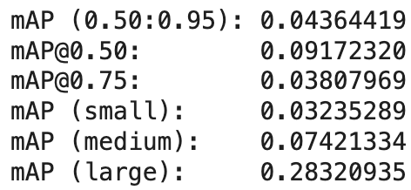
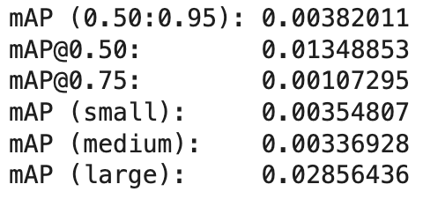
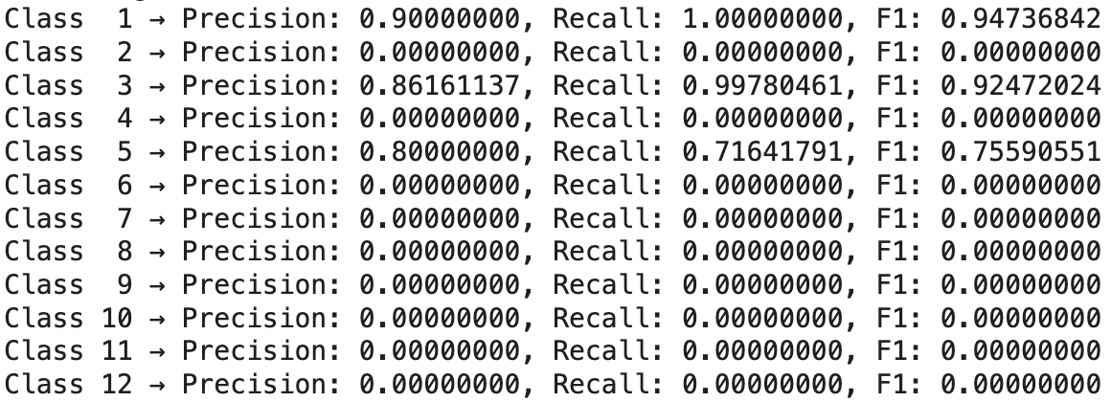
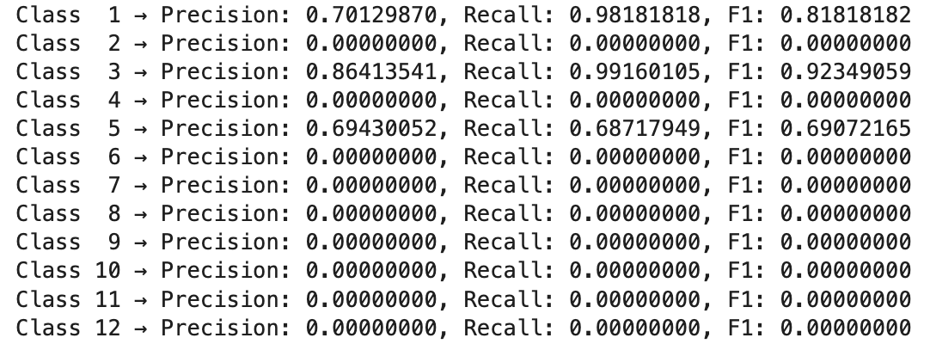
Model Evaluation
Baseline Model evaluation Custom Model evaluation

Slide 13
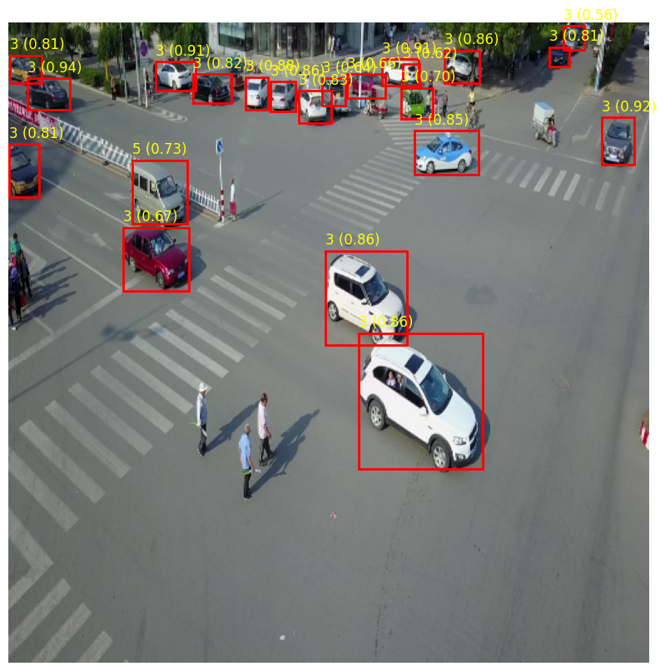
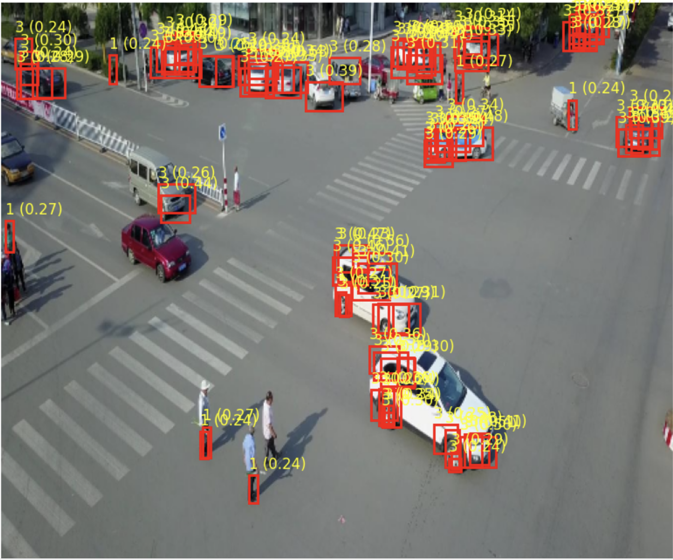
Baseline Model prediction Custom Model prediction

Slide 14
8) Conclusions
Significantly more understanding of neural network architectures → a deeper learning of deep learning
At the end of the day, our custom model was not very good → pre-trained neural networks with just a few small tweaks are extremely powerful
Iterative model building is a must
Computational resources and impact of GPUs on training time and model complexity is highly important
Faced many challenges over the course of the project → working with GBs of images and extremely slow training is frustrating

Slide 15
Thank you!

